Slide 1
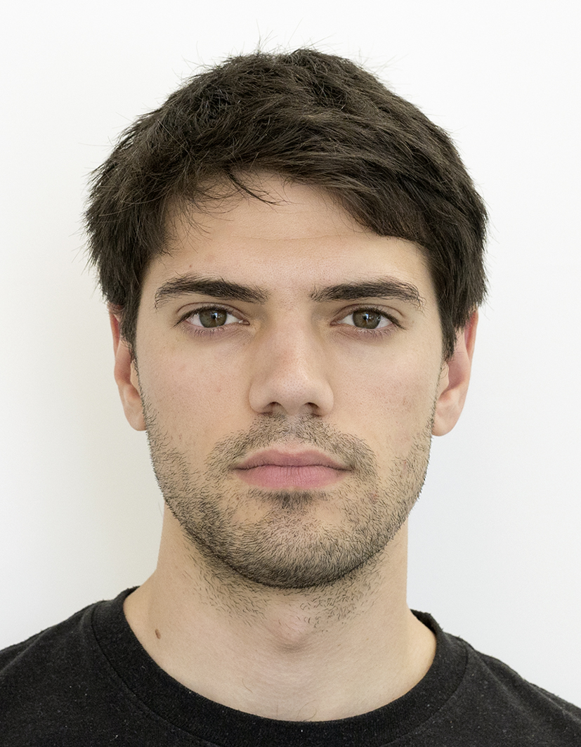

Cryptographically Privileged State Estimation With Gaussian Keystreams
Conference on Decision and Control (CDC) 2021
Marko Ristic, Benjamin Noack, Uwe D. Hanebeck
Autonomous Multisensor Systems Group
Institute for Intelligent Cooperating Systems
Faculty of Computer Science
Otto von Guericke University, Magdeburg
16.12.2021

Slide 2










Privacy in Networked Environments
Growing number of public networks
Increasing need to provide privacy guarantees
Variety of task-specific privacy goals
Untrusted cloud
Eavesdroppers
Partial Leakages
Privileged Users

Slide 3
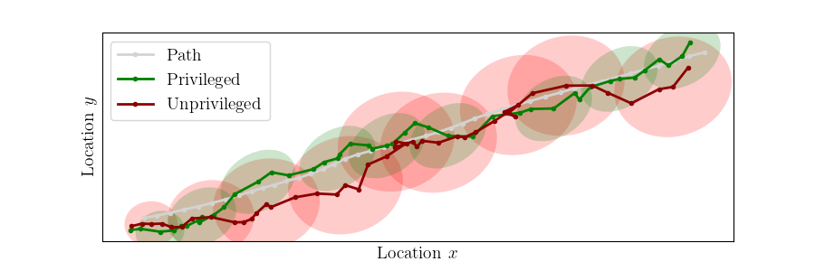
Privilege in Estimation
Want privileged users to perform better than unprivileged ones
Want to guarantee a minimum difference in performance
Want privilege to be provided by a single key
How to quantify a difference in estimation?

Slide 4

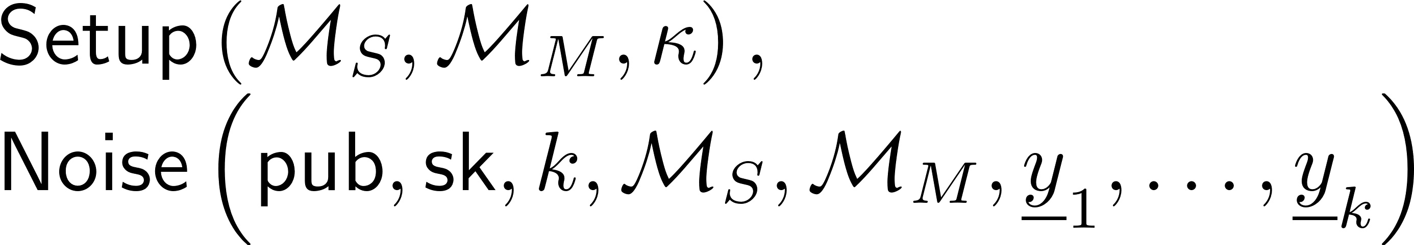




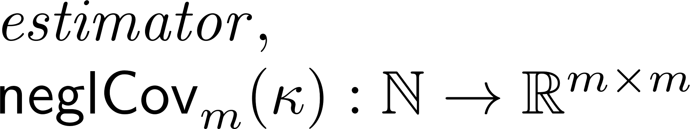
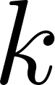
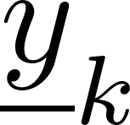
Cryptographic Formulation
Required algorithms
Required definitions
Ready to define a notion of privilege
System Model
Measurement Model
Security Parameter
Public Parameters
Secret key
Timestep
Measurement

Slide 5
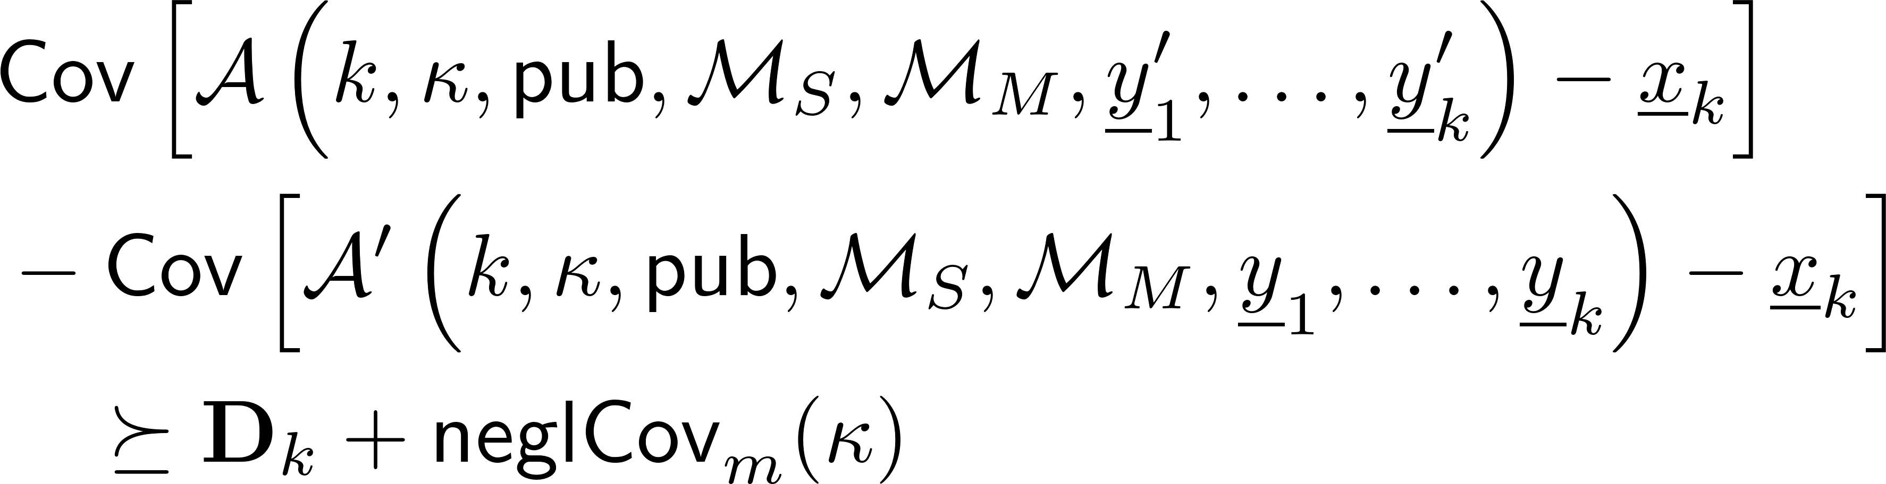
Cryptographic Formulation cont.
Notion of privilege
Note that the above could be guaranteed in practice only when models are exact

Slide 6
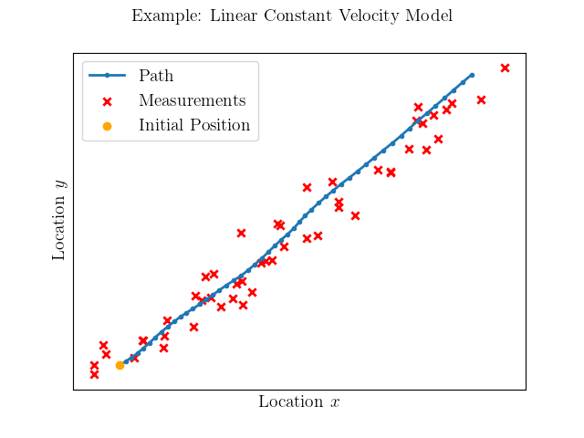
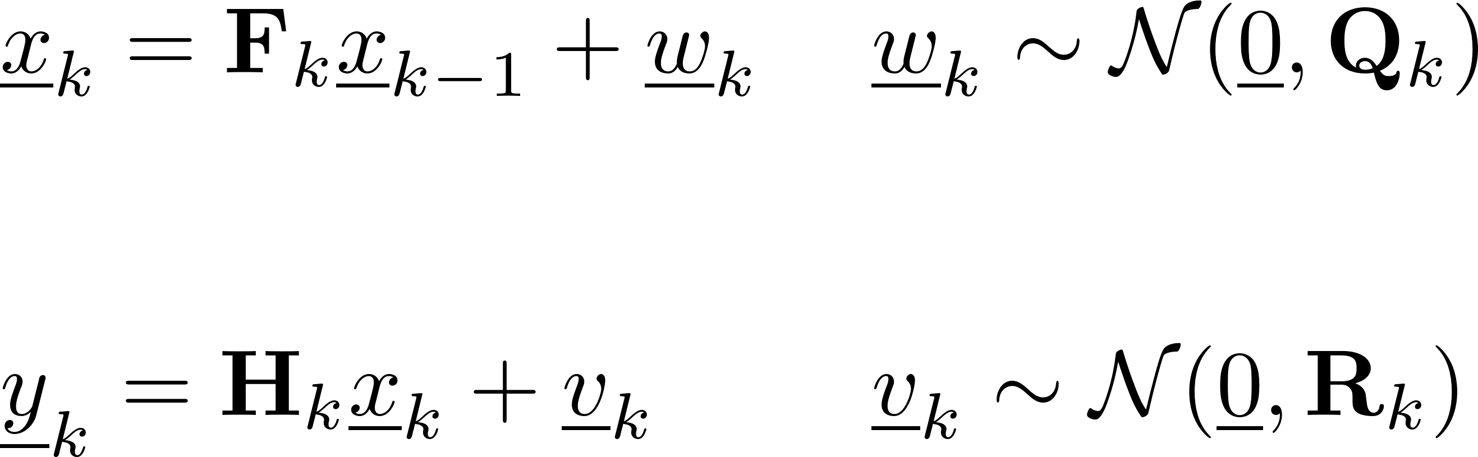
Estimation Problem
Consider linear models
Existing optimal solution w.r.t. MSE (Kalman Filter) can be used to prove privilege notion

Slide 7

Gaussian Keystream
Stream cipher
Convert to pseudorandom multivariate Gaussian samples with parameter
Cryptographically Indistinguishable from true Gaussian samples without key
Assumes floats represent real numbers – reasonable for practical applications

Slide 8
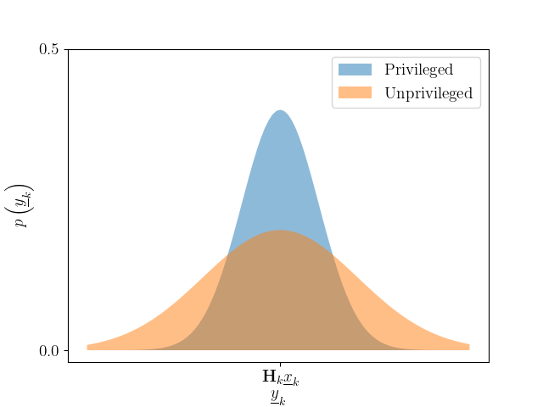
Additional Noise and the Observed Models
Adding Gaussian stream to measurements (key and index required to remove it)
Observed measurement model differs for unprivileged estimators
Privileged
Unprivileged

Slide 9
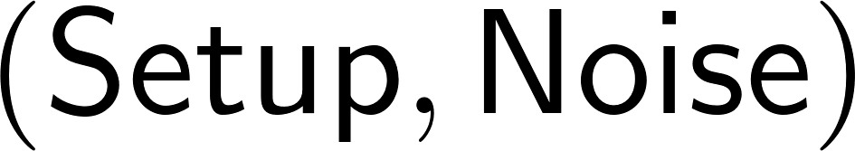
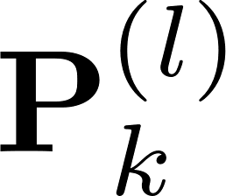
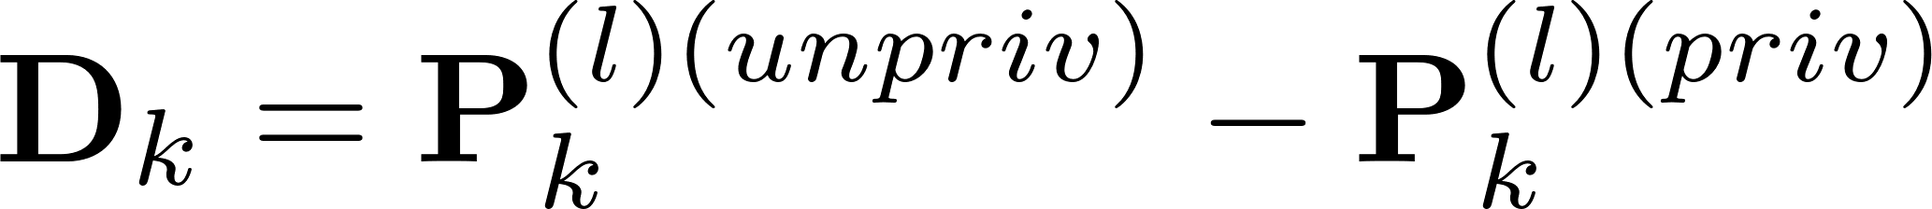
Proof Sketch
Define
Lowest possible estimate covariance computable with optimal linear Kalman Filter
Difference series of best possible privileged and unprivileged covariances gives covariance series for cryptographic notion
Estimator which could break scheme would estimate better than KF – proof by contrapositive

Slide 10
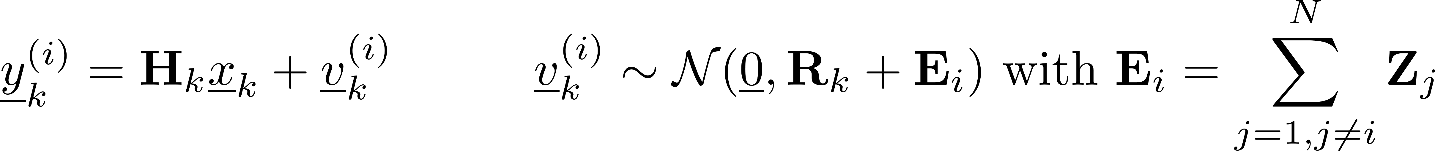
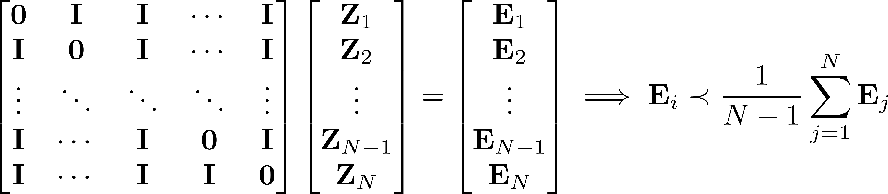
An Extension to Multiple Privileges
Consider multiple keys and multiple Gaussian keystreams added to measurements
Single key removes single noise. Observed models are now
Choosing additional noises for each single key holder would require additional condition

Slide 11
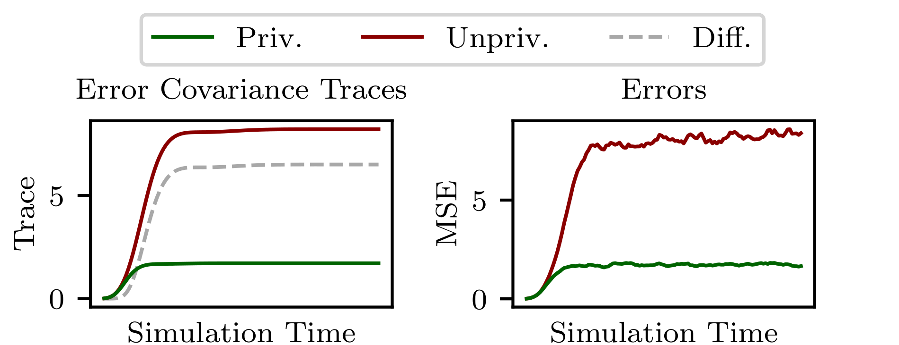
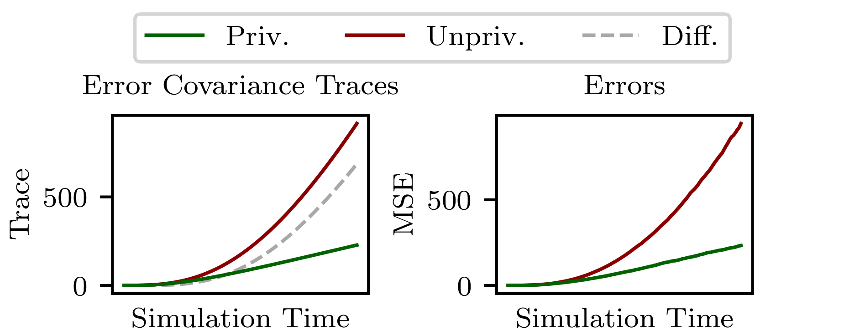
Simulations
Examples for observable and unobservable systems
Trace of difference equals the trace of the privilege covariance series

Slide 12
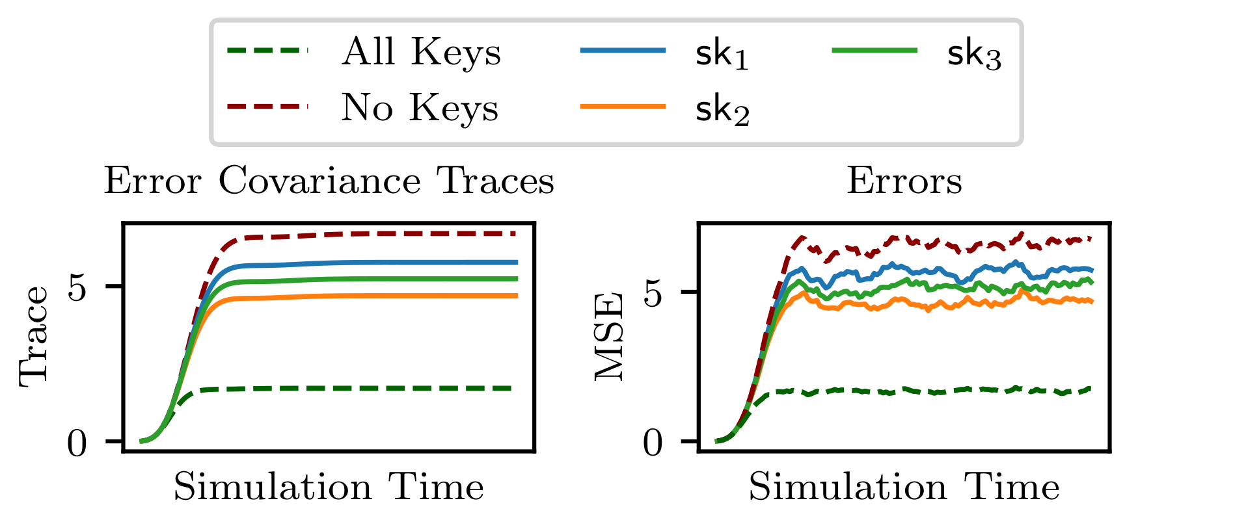
Simulations cont.
Example for multiple privileges

Slide 13
Thank You
Future directions
Multiple privileges with less restrictions
Fusion and privileges
Broader formal security
Phone: +49 391 67 57591
Email: marko.ristic@ovgu.de
Web: https://ams.ovgu.de

